Slide 1
Matrix Completion
STAT 542 Final Project Group 11

Slide 2


Outline
Dataset Introduction
Models
Results Comparison (RMSE)
Difficulties
2
2
2

Slide 3
Dataset Introduction

Slide 4
Dataset Introduction
Motivation
Most of the ratings are 3, and could be due to that the students have not tried the restaurants
The dataset was collected from students, and we want to obtain a similar dataset from students to work on
Description
Created an identical survey with the same 15 restaurants and the same rating scale (1 to 5)
Collected from 50 students of UIUC
(n, p) = (50, 15)
4
4
Notes:
Images can be taken at different times, varying lighting, facial expressions and details

Slide 5
K Nearest Neighbor

Slide 6
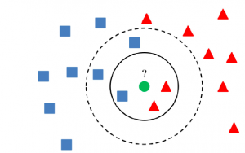
KNN
Methodology
Compute similarity of the data points
Define k nearest neighbor
6
6

Slide 7


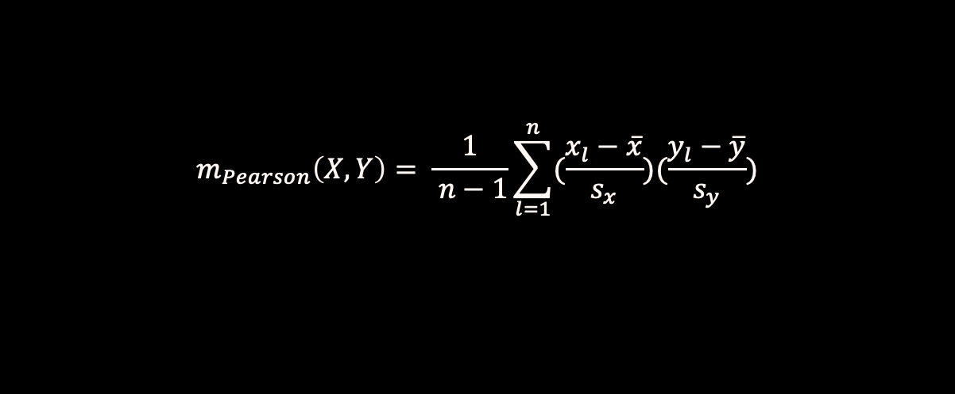

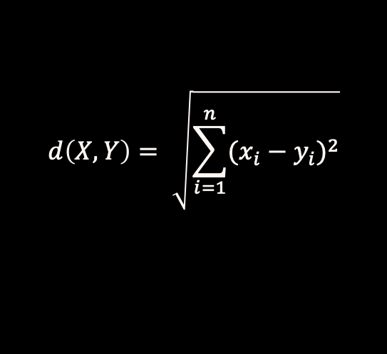
Similarity Measures
Pearson correlation:
$$m_{Pearson}\left(X,Y\right)= \frac{1}{ n−1}\sum_{l=1}^{n}{(\frac{x_{l}−\overline{x}}{s_{x}})(\frac{y_{l}−\overline{y}}{s_{y}})}$$
, Similarity s $= \frac{m+1}{2}$
Cosine Similarity:
$$m_{cosine}\left(X,Y\right)= \frac{X∙Y}{ \left\|X\right\|\left\|Y\right\|}$$
, Similarity s $= \frac{m+1}{2}$
Euclidean Distance:
$$d\left(X,Y\right)= \sqrt{\sum_{i=1}^{n}{{(x_{i}−y_{i})}^{2}}}$$
, Similarity s $= \frac{1}{1+d}$
7
7
Notes:
Similarity s is transformed from range [-1,1] to [0,1]

Slide 8
User-Based Collaborative Filtering Using KNN

Slide 9
User-Based Collaborative Filtering
Methodology
Find a neighborhood of similar users:
Missing ratings are skipped in the calculation.
Compute similarity.
Define number k of nearest neighbors (select highest similarity).
Predict missing ratings by taking the average rating of users in the k nearest neighborhood.
9
9

Slide 10
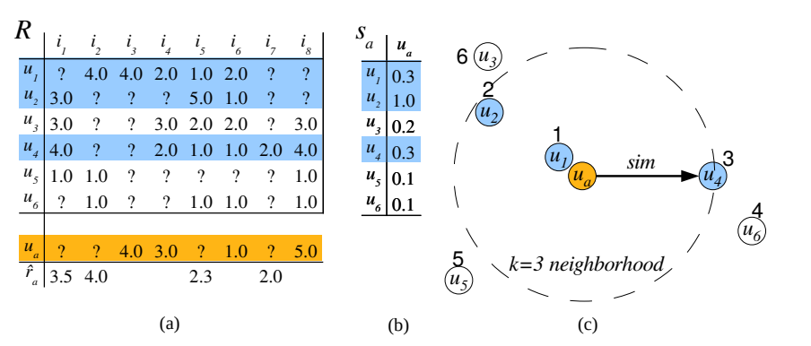
User-Based Collaborative Filtering
Methodology
10
10
https://cran.r-project.org/web/packages/recommenderlab/vignettes/recommenderlab.pdf

Slide 11
User-Based CF using KNN
Results
Similarity measure
Chosen K
RMSE
Pearson
0.8609
10
20
0.8394
Pearson
Cosine
10
0.6780
Cosine
20
0.6484
Euclidean
10
0.6896
Euclidean
20
0.6525
11
11

Slide 12
Item-Based Collaborative Filtering Using KNN

Slide 13
Item-Based Collaborative Filtering
Methodology
Find a neighborhood of similar items:
Missing ratings are skipped.
Compute similarity.
Define number k of nearest neighbors (select highest similarity).
Predict missing ratings by taking the weighted-average rating of items in the k nearest neighborhood.
Weight: similarity
Rating: user’s rating matched similar items
13
13

Slide 14
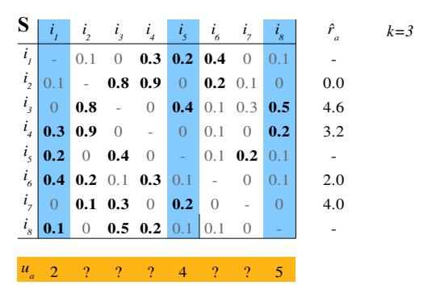
Item-Based Collaborative Filtering
Methodology
14
14
https://cran.r-project.org/web/packages/recommenderlab/vignettes/recommenderlab.pdf

Slide 15
Item-Based CF using KNN
Results
Similarity measure
Optimal K
RMSE
Pearson
7
0.6829
Cosine
8
0.6338
Euclidean
11
0.6337
15
15

Slide 16
Singular Value Decomposition (SVD)

Slide 17
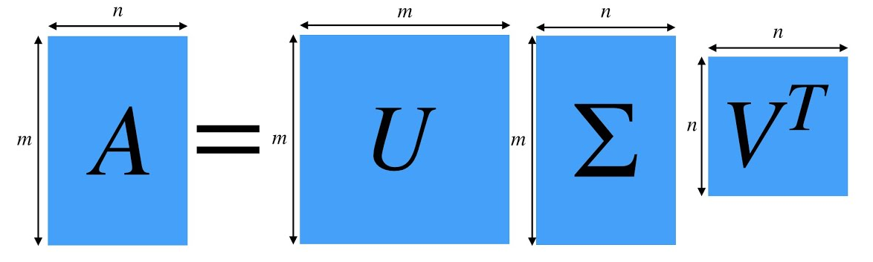

SVD
Methodology
Singular Value Decomposition (SVD) of a matrix A is a factorization into three matrices U, Σ, and V, with U and V being orthogonal matrices and Σ being a diagonal matrix with singular value entries.
$$A=U\text{Σ}V^{T}$$
17
$$f\left(X\right)=β_{0}+β_{1}X_{1}+β_{2}X_{2}+…+β_{p}X_{p}+ε$$
17

Slide 18
Iterative SVD
Steps:
Initial guess for NaN values in the matrix A
Apply SVD to A
Apply Low-Rank Matrix Approximation
Replace the known value in A to get matrix A’
Repeat the process until the difference between A and A’ is less than a pre-determined threshold
*Note that the results highly depend on the initial matrix.
18
18

Slide 19
SVD
Results
How NaN values were initialized
RMSE
3
0.5080
Row mean
0.4435
Column mean
0.4070
What if we used other initial matrices to implement SVD?
19
19

Slide 20
KNN+SVD
Steps:
Use the results from KNN as matrix A
Apply SVD to A
Apply Low-Rank Matrix Approximation
Replace the known value in A to get matrix A’
Repeat the process until the difference between A and A’ is less than a pre-determined threshold
20
20

Slide 21
KNN+SVD
Results
KNN
RMSE
User-Based
0.4350
Item Based
0.4016
21
21

Slide 22
Results Comparison

Slide 23
Results Comparison
Item-Based
KNN
Used-Based
KNN
SVD
KNN+SVD
RMSE
0.6337
0.6484
0.4070
0.4016
23
23

Slide 24
Difficulties

Slide 25
Difficulties
Problem 1- Dataset
We observed that most of the values in the provided dataset contains 3, making google reviews or other ratings online unreliable
Solution:
We decided to collect our own dataset, in ways that maximizes its similarity with Feedback.csv
25
25

Slide 26
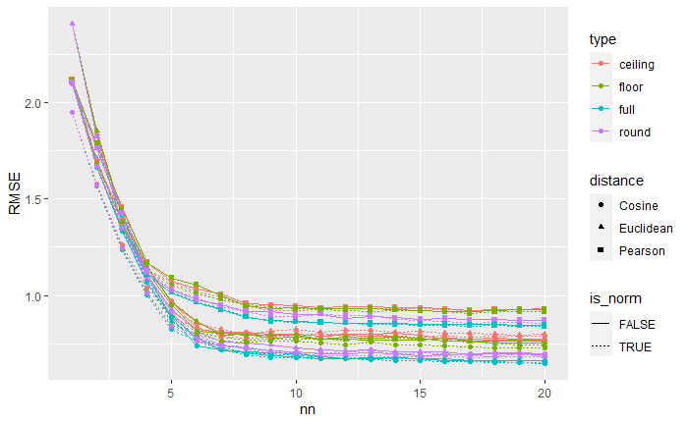
Difficulties
Problem 2- User-Based CF
Although increasing k still results in a decrease in RMSE, the decrease is only marginal after reaching k=10
Solution:
Decided to choose k=20 as it covers around 50% of the data
26
26

Slide 27
Difficulties
Problem 3- User-Based and Item-Based CF
User rating bias: some users tend to use higher ratings while some tend to use lower ratings
Solution:
Center the rows of user-item rating by doing normalization
$$h\left(r_{jl}\right)=r_{jl}−\overline{r_{j}}$$
27
27

Slide 28
Thank you

